Slide 1

ONLINE RETAIL ANALYSIS
BHUVANESWARI KAPULURU

Slide 2
Agenda
Problem
statement
Data
Clean data
Feature engineering
Visualisation
Presentation Title

Slide 3
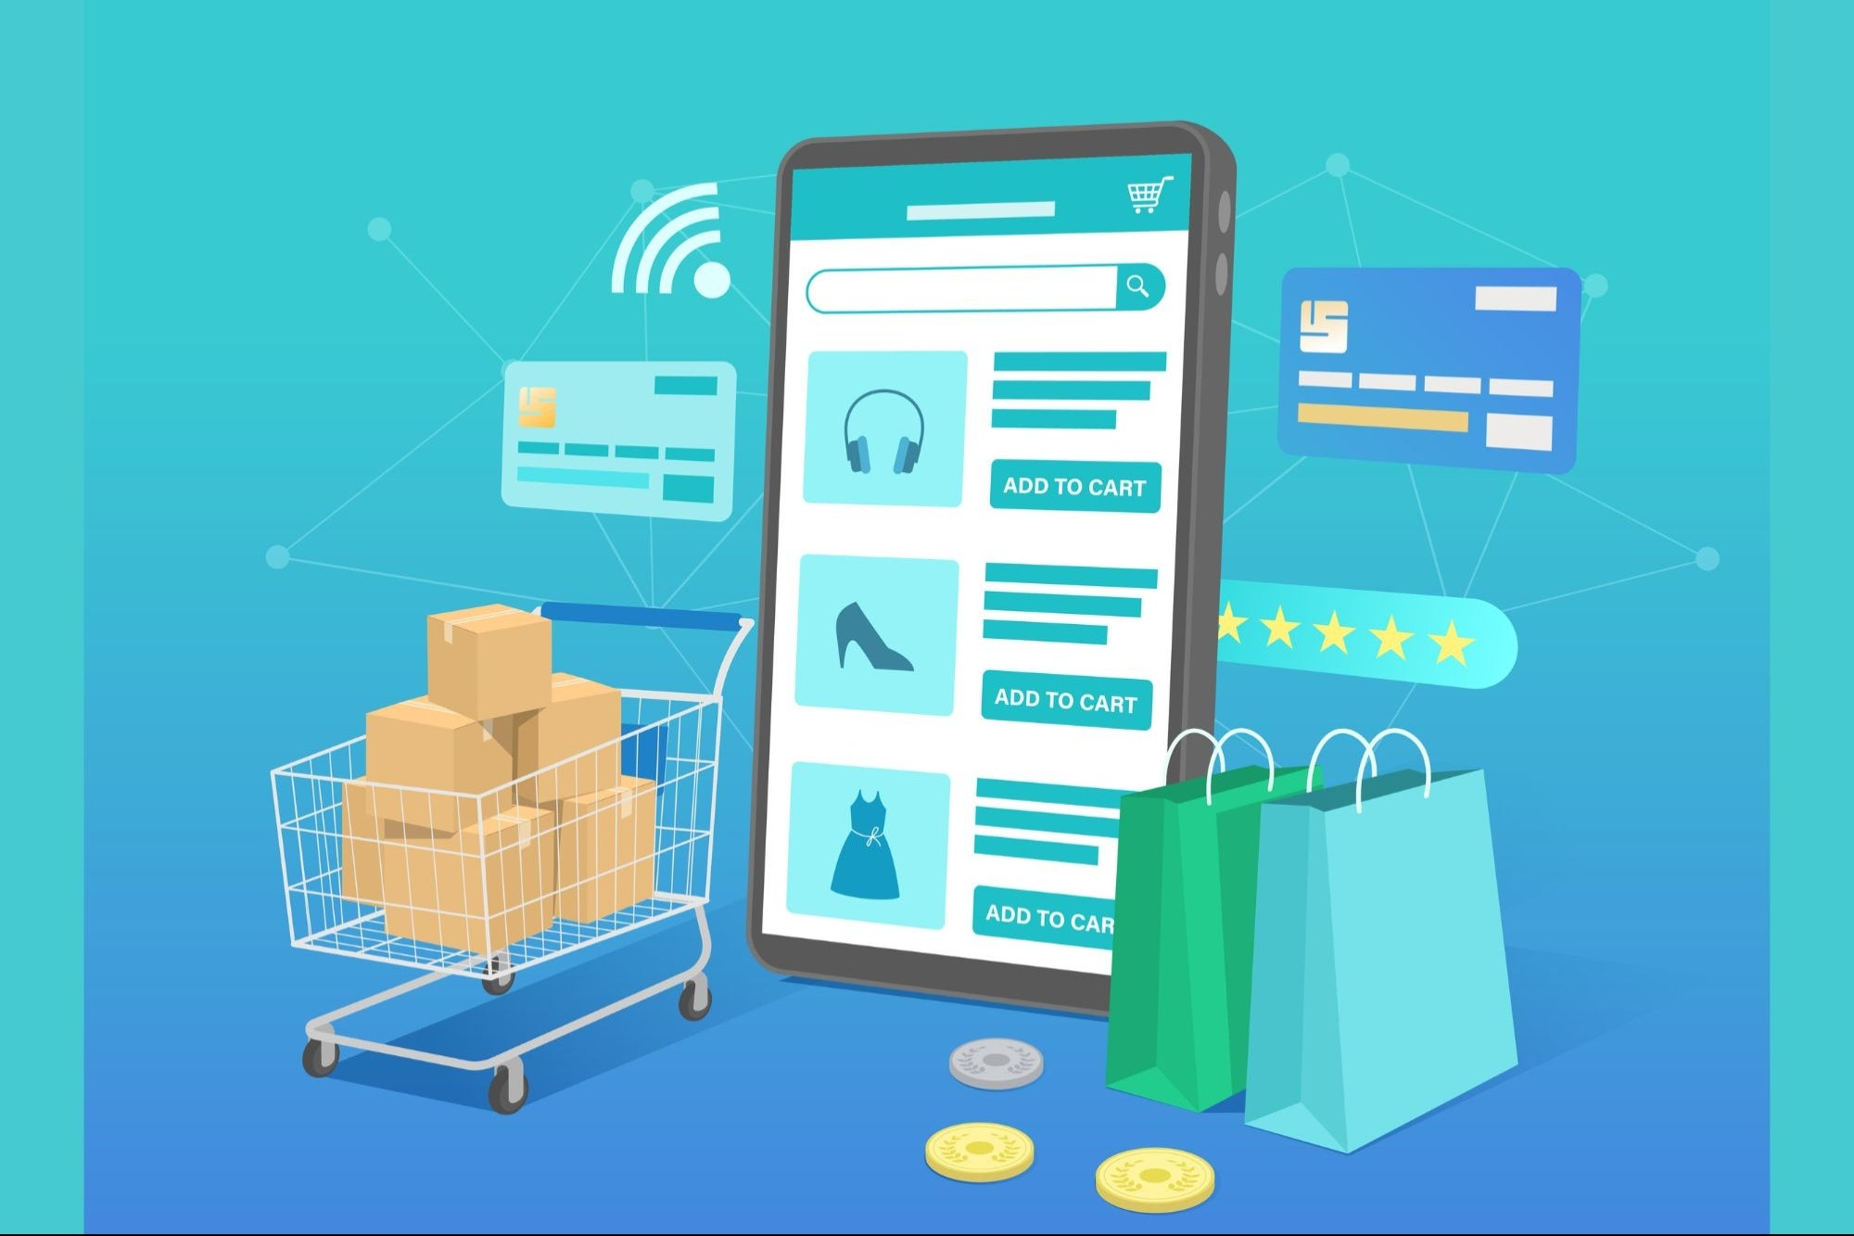
Problem statement
The retail dataset contains thousands of transactions across multiple countries.
Management lacks a clear understanding of:
Customer behavior trends
Purchase patterns across months and countries
Customer retention and churn risks

Slide 4
Steps In Data Analysis
1.Load data
2.Handle
Missing
Data
3.Feature
engineering
4.visualisation
5.Rfm
analysis
6.Churn
analysis

Slide 5

Data loading

Slide 6


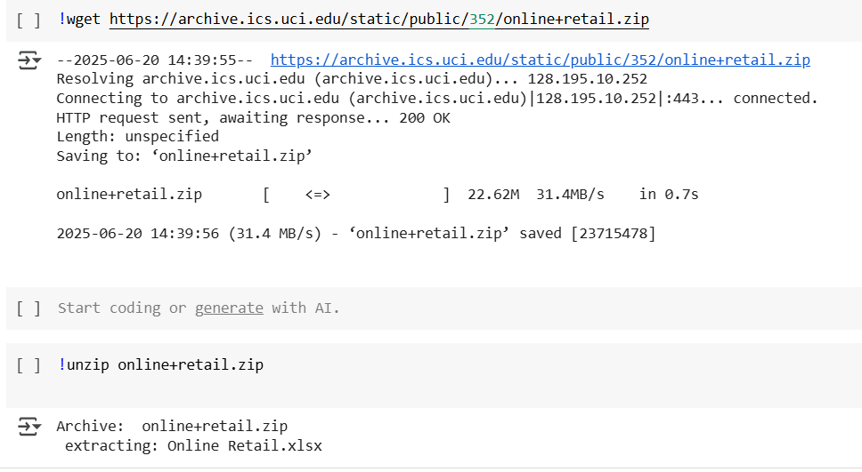


Data loading

Slide 7


2.Handling missing values

Slide 8
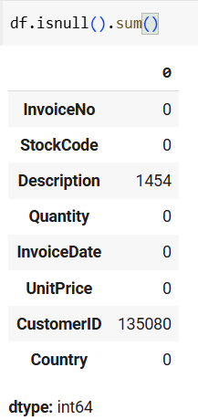
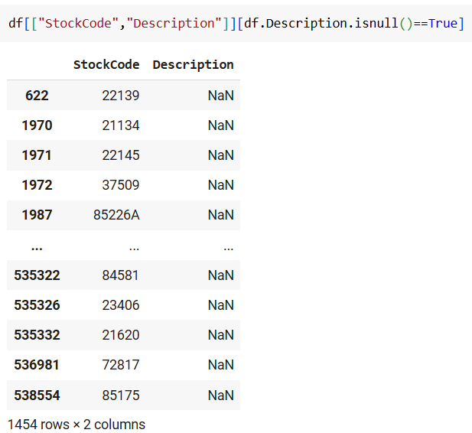
Identifying null values

Slide 9
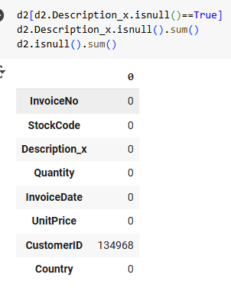
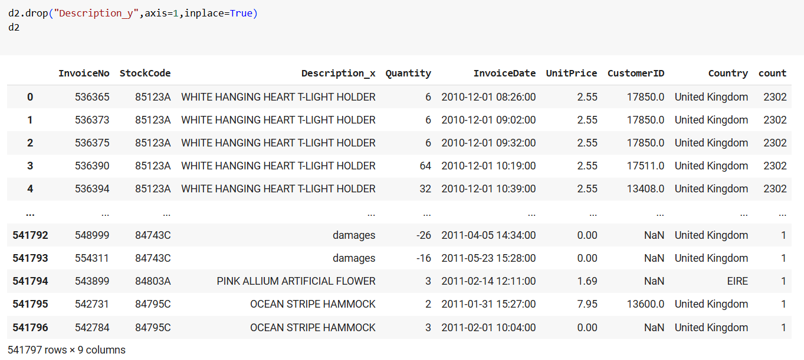
Handled null values

Slide 10

3.Feature engineering

Slide 11
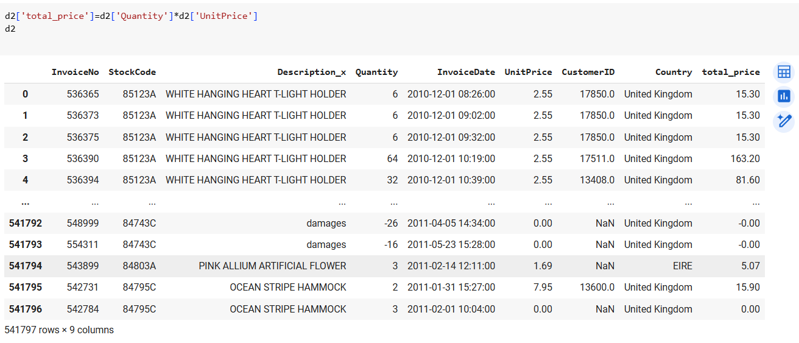
Adding total price column

Slide 12
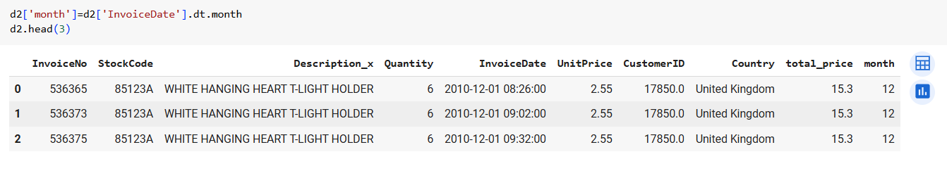
Adding month column

Slide 13
4.Visualisation

Slide 14
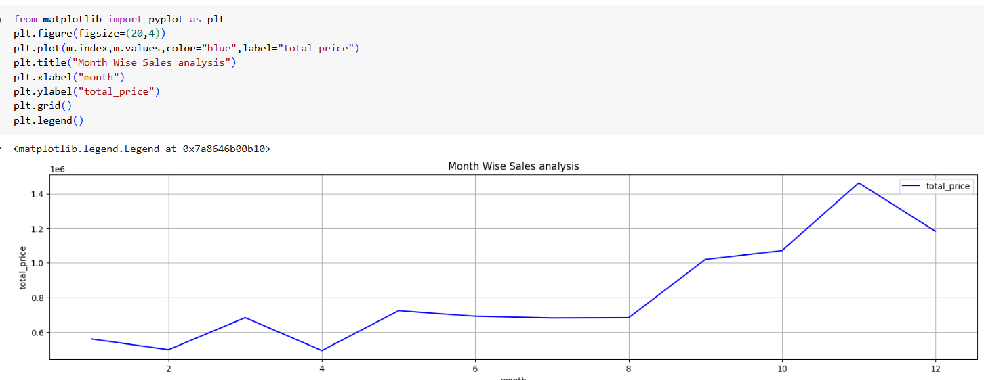
Month wise sales analysis

Slide 15
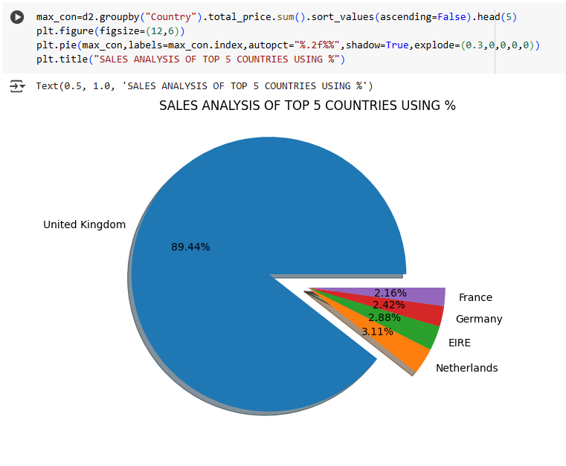
Sales analysis of top 5 countries in %

Slide 16
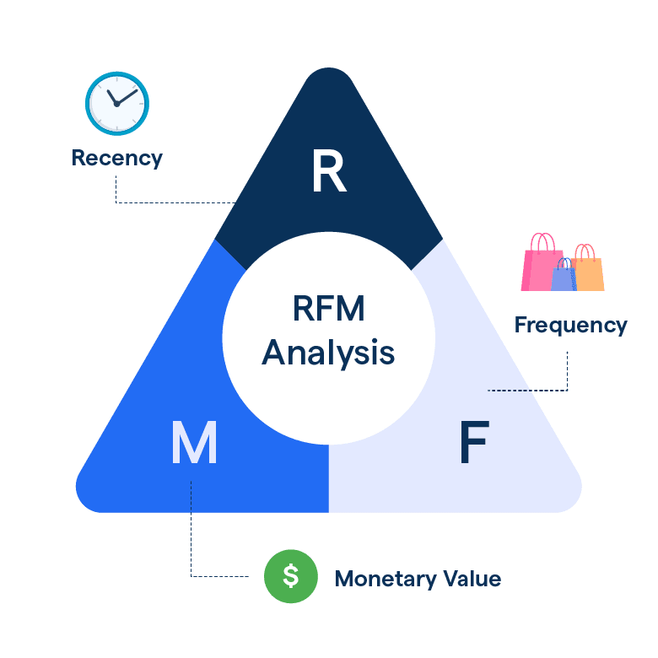
5.Rfm analysis

Slide 17
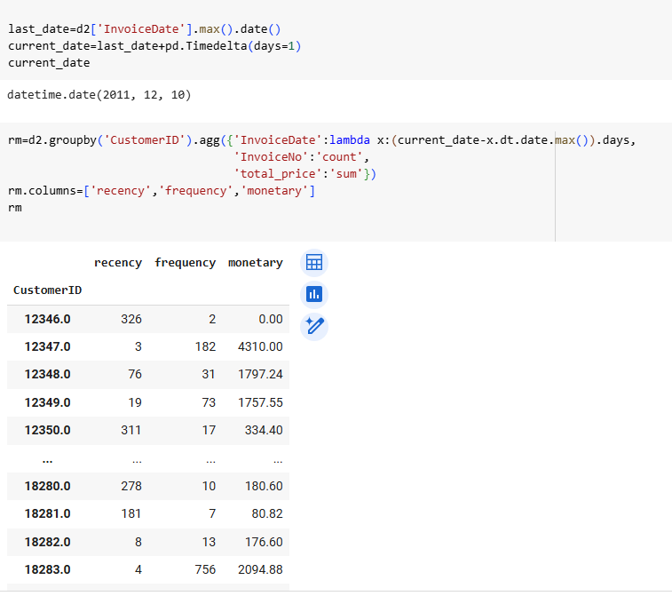
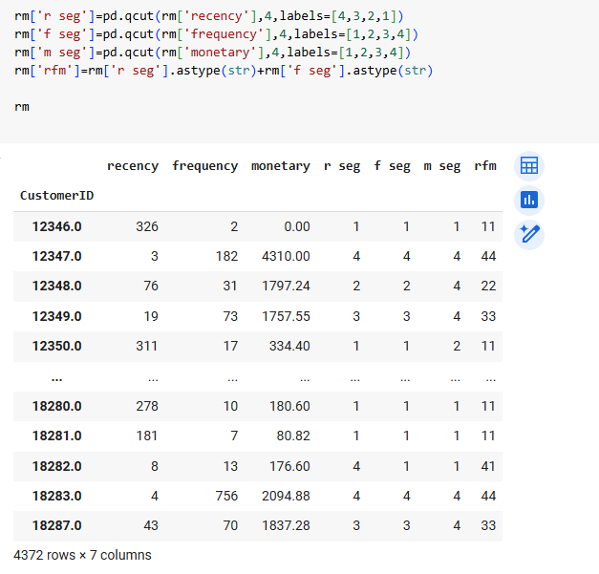
Rfm and Rfm segments

Slide 18
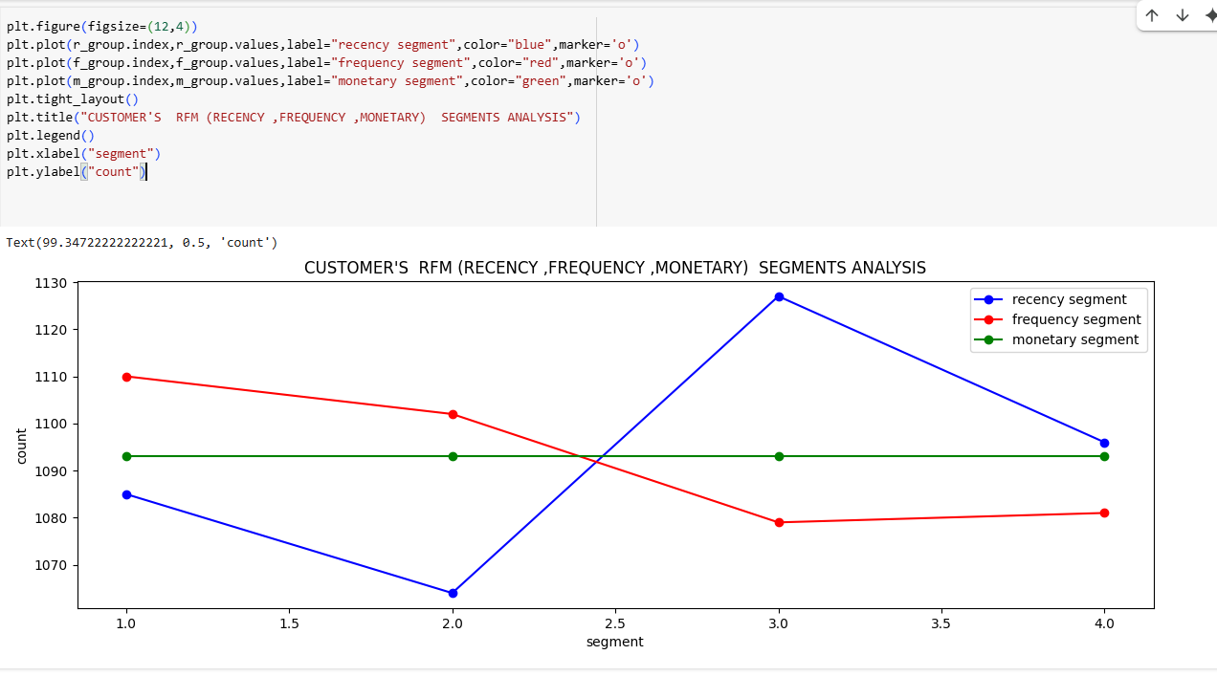
Rfm segments analysis using graph

Slide 19
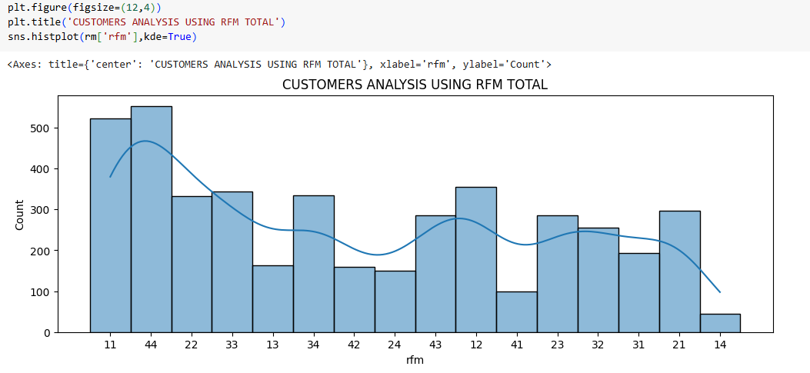
Customers analysis using rfm total

Slide 20

6.Churn analysis

Slide 21
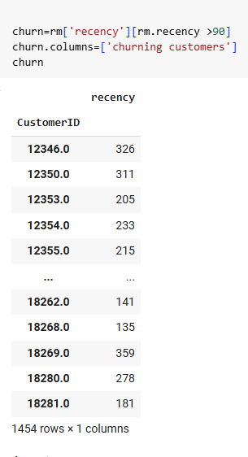
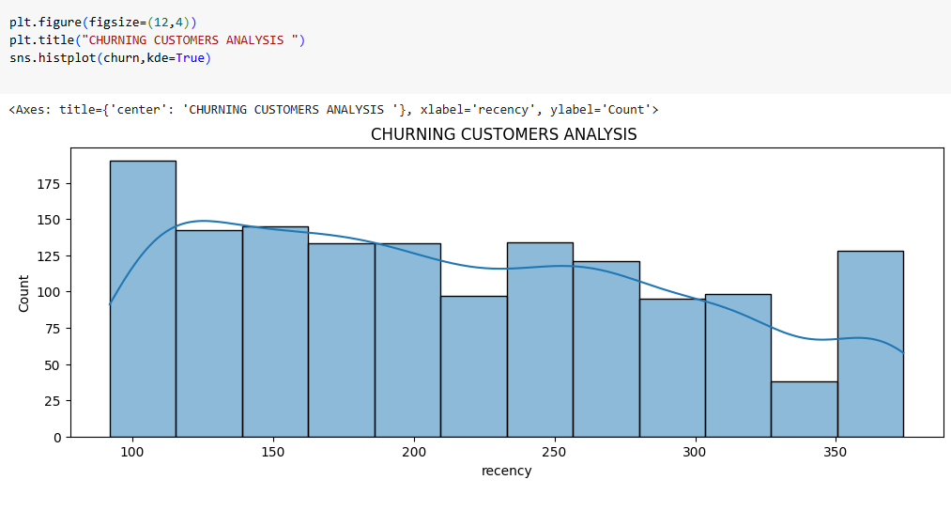
Churn analysis

Slide 22

Overall insights

Slide 23
Insights
🔁 Majority of customers purchased only once (Frequency score 1.0), showing low repeat engagement.
📈 Sales increased steadily, with notable peaks during the 8th to 12th months.
🌍 UK dominates sales, contributing 89% of total revenue.
🕒 Many customers haven’t purchased recently (Recency score 3.0 – 1130 users), indicating churn risk.

Slide 24
Insights
🚨 Customers with recency between 100–350 days are likely to churn and should be prioritized.
💰 Spending remains consistent across all customer segments (Monetary score).
⚖️ Balanced number of high and low RFM scores — mix of loyal and disengaged users.

Slide 25

Recommendations

Slide 26
Recommendations
Contact churned customers with updates about new features, products, or personalized offers to bring them back.
Implement a visit-based discount program (e.g., after 5 visits, give a special discount) to improve recency and frequency.
Use regional retailers or partners in countries like France, Germany, and the Netherlands to grow international reach.
Invest in marketing and inventory during high-sales months like September to December to leverage year-end demand.

Slide 27




Thank you
Bhuvaneswari Kapuluru
bhuvaneswari2821@gmail.com

